Slide 1
OrganicLink A Computer Vision Marketplace for Irish Organic Producers with Automated Produce Quality Grading Aashrith Sai Yamsani Student ID : 25287419 Supervisor: Dr. Elfed Lewis
Master of Engineering in Computer Vision & Artificial Intelligence
Final Project Presentation | University of Limerick

Slide 2

Project Overview
Problem Statement
Irish organic producers struggle to trade directly with buyers because quality cannot be verified at a distance. ~30% of fruit & vegetables are rejected on cosmetic grounds (Irish Examiner, 2024), 122,000+ tonnes of vegetables are lost annually (EPA/DAFM, 2024), and 70% of organic lamb / 30% of organic cattle are sold as conventional, losing the premium (Agriland, 2024).
Project Aim
Design and build a web-based marketplace that connects organic farmers directly with buyers, using computer vision to verify produce quality and to establish trust in remote transactions.
Key Objectives
Investigate the market-access problem through literature and primary consultation (Teagasc)
Design and implement a computer-vision model for produce identification and quality grading
Design a dual-inspection protocol verifying quality at both dispatch and delivery
Extend grading to multi-item photographs via a two-stage detection and classification pipeline
Evaluate rigorously, including dataset integrity (deduplication) and honest reporting of limitations
2

Slide 3
Project Origin: From the Digital Futures Lab to OrganicLink
Originated in the DFL (DFI Pod 2, Team 6) with the Midwest Bio District: an organic dairy coordination platform
Consulted Joe Kelleher, organic dairy specialist at Teagasc - the national organic milk pool was too small and fragmented to justify processing investment; better coordination alone could not fix it
Pivoted to the broader, better-evidenced problem: the lack of trust and quality verification in direct organic trade — leading to OrganicLink
Dataset
Two public Kaggle produce datasets combined: 14 product classes, binary fresh/defect labels
46,867 total images across the combined training set
Class sizes ranged from ~400 images (grape, jujube) to 7,700+ images (apple, banana, orange)
Perceptual hashing identified 34.7% near-duplicate images (16,267 of 46,867) - near-duplicate group entirely on one side, preventing leakage
Held-out test set: 2,929 images, never seen during training
A third public dataset was assessed and excluded: it would have raised near-duplicate contamination from 34.7% to 61.8%, adding little genuine variety
3

Slide 4
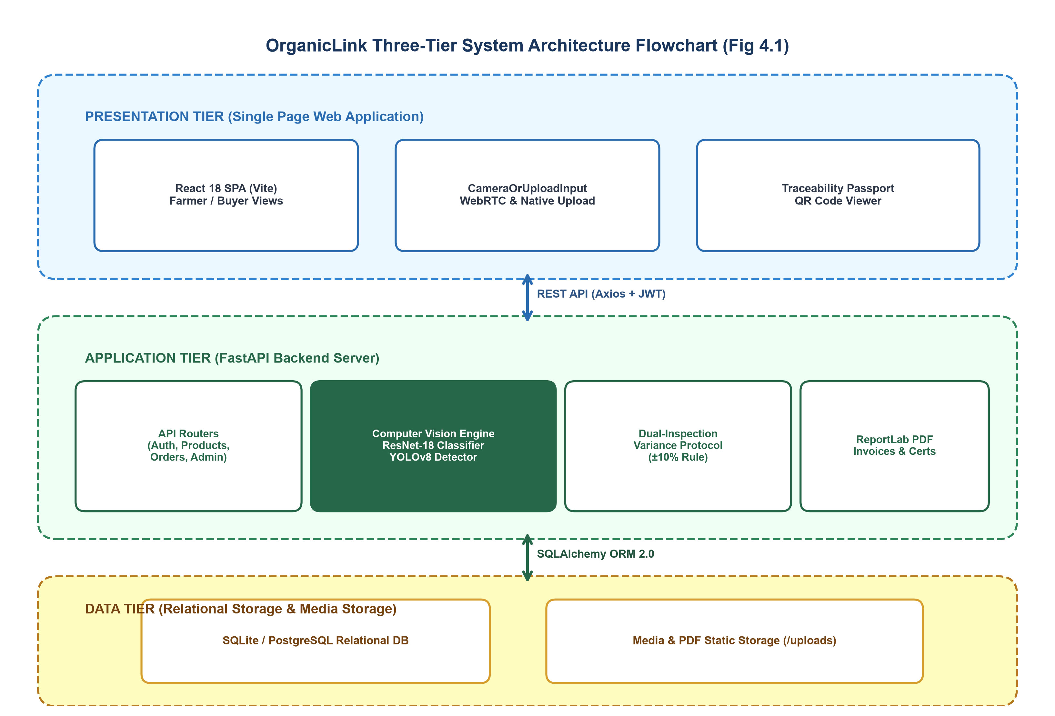
The Solution
A Computer Vision Marketplace for Irish Organic Producers with Automated Produce Quality Grading
4

Slide 5
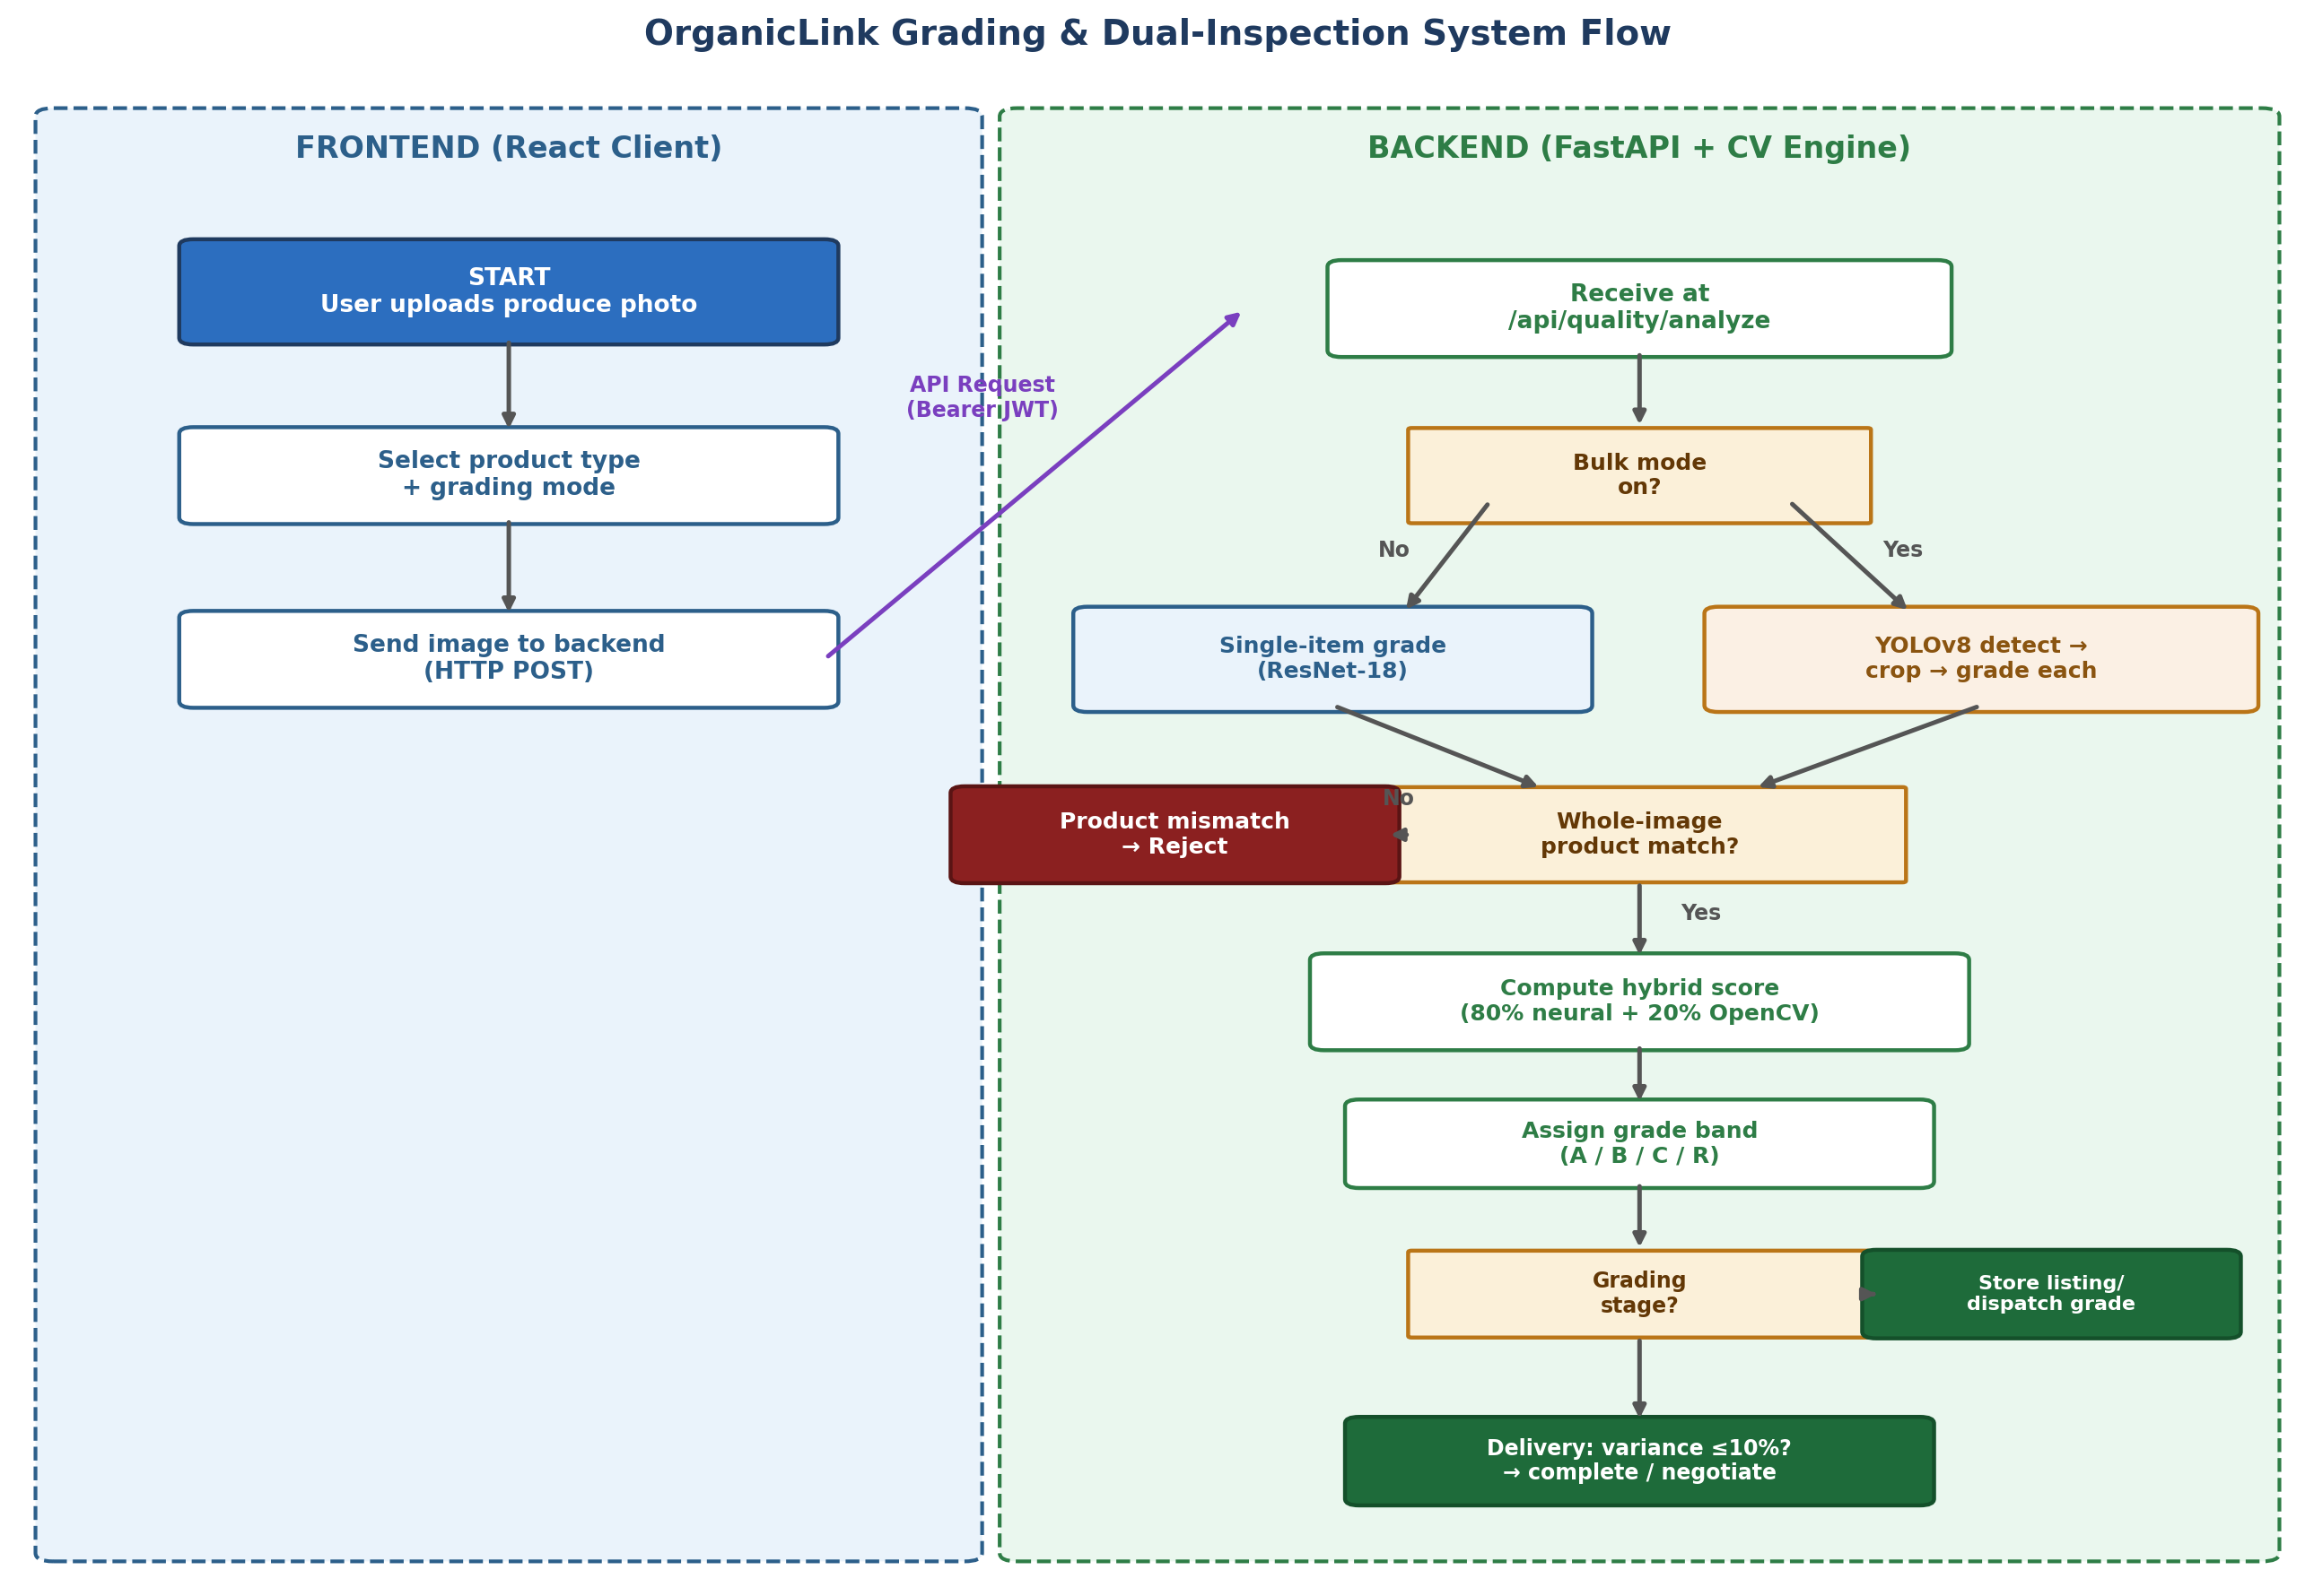
System Workflow
End-to-end flow: upload, grading, product-match check, dual-inspection decision
2

Slide 6
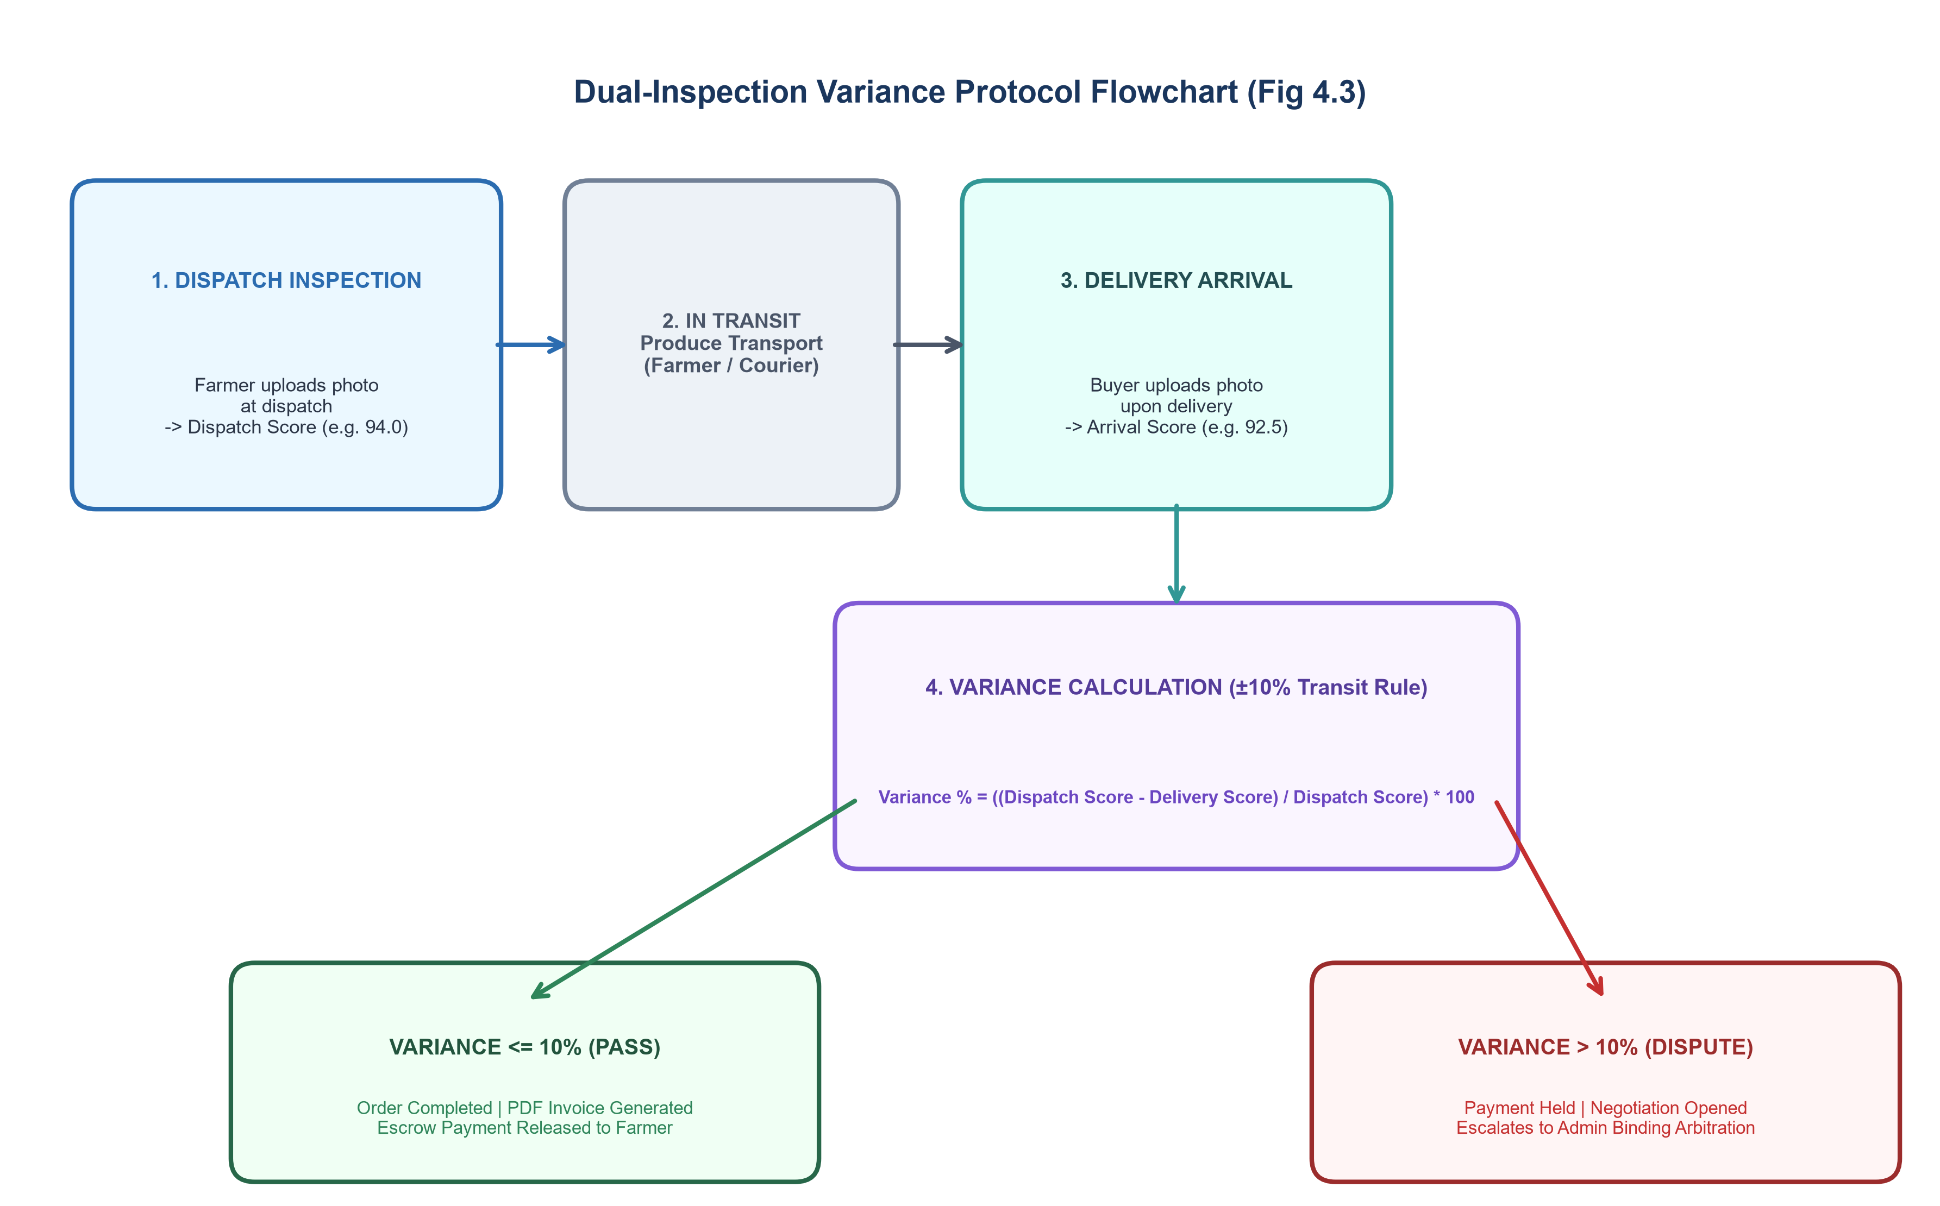
Core Contribution: Dual-Inspection Variance Protocol
Produce is graded at dispatch and again at delivery. If quality drops beyond tolerance, the transaction is automatically flagged, payment is held, and negotiation opens — replacing subjective disagreement with objective evidence.
5

Slide 7
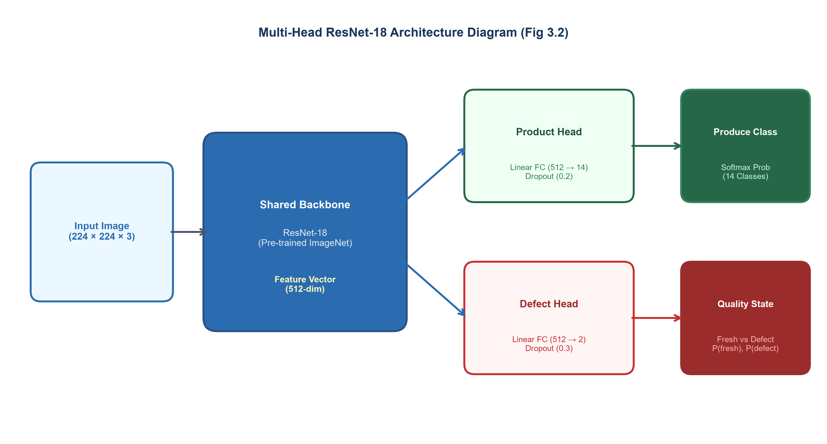
The Computer Vision
Multi-head ResNet-18: one shared backbone, two Headed
6

Slide 8
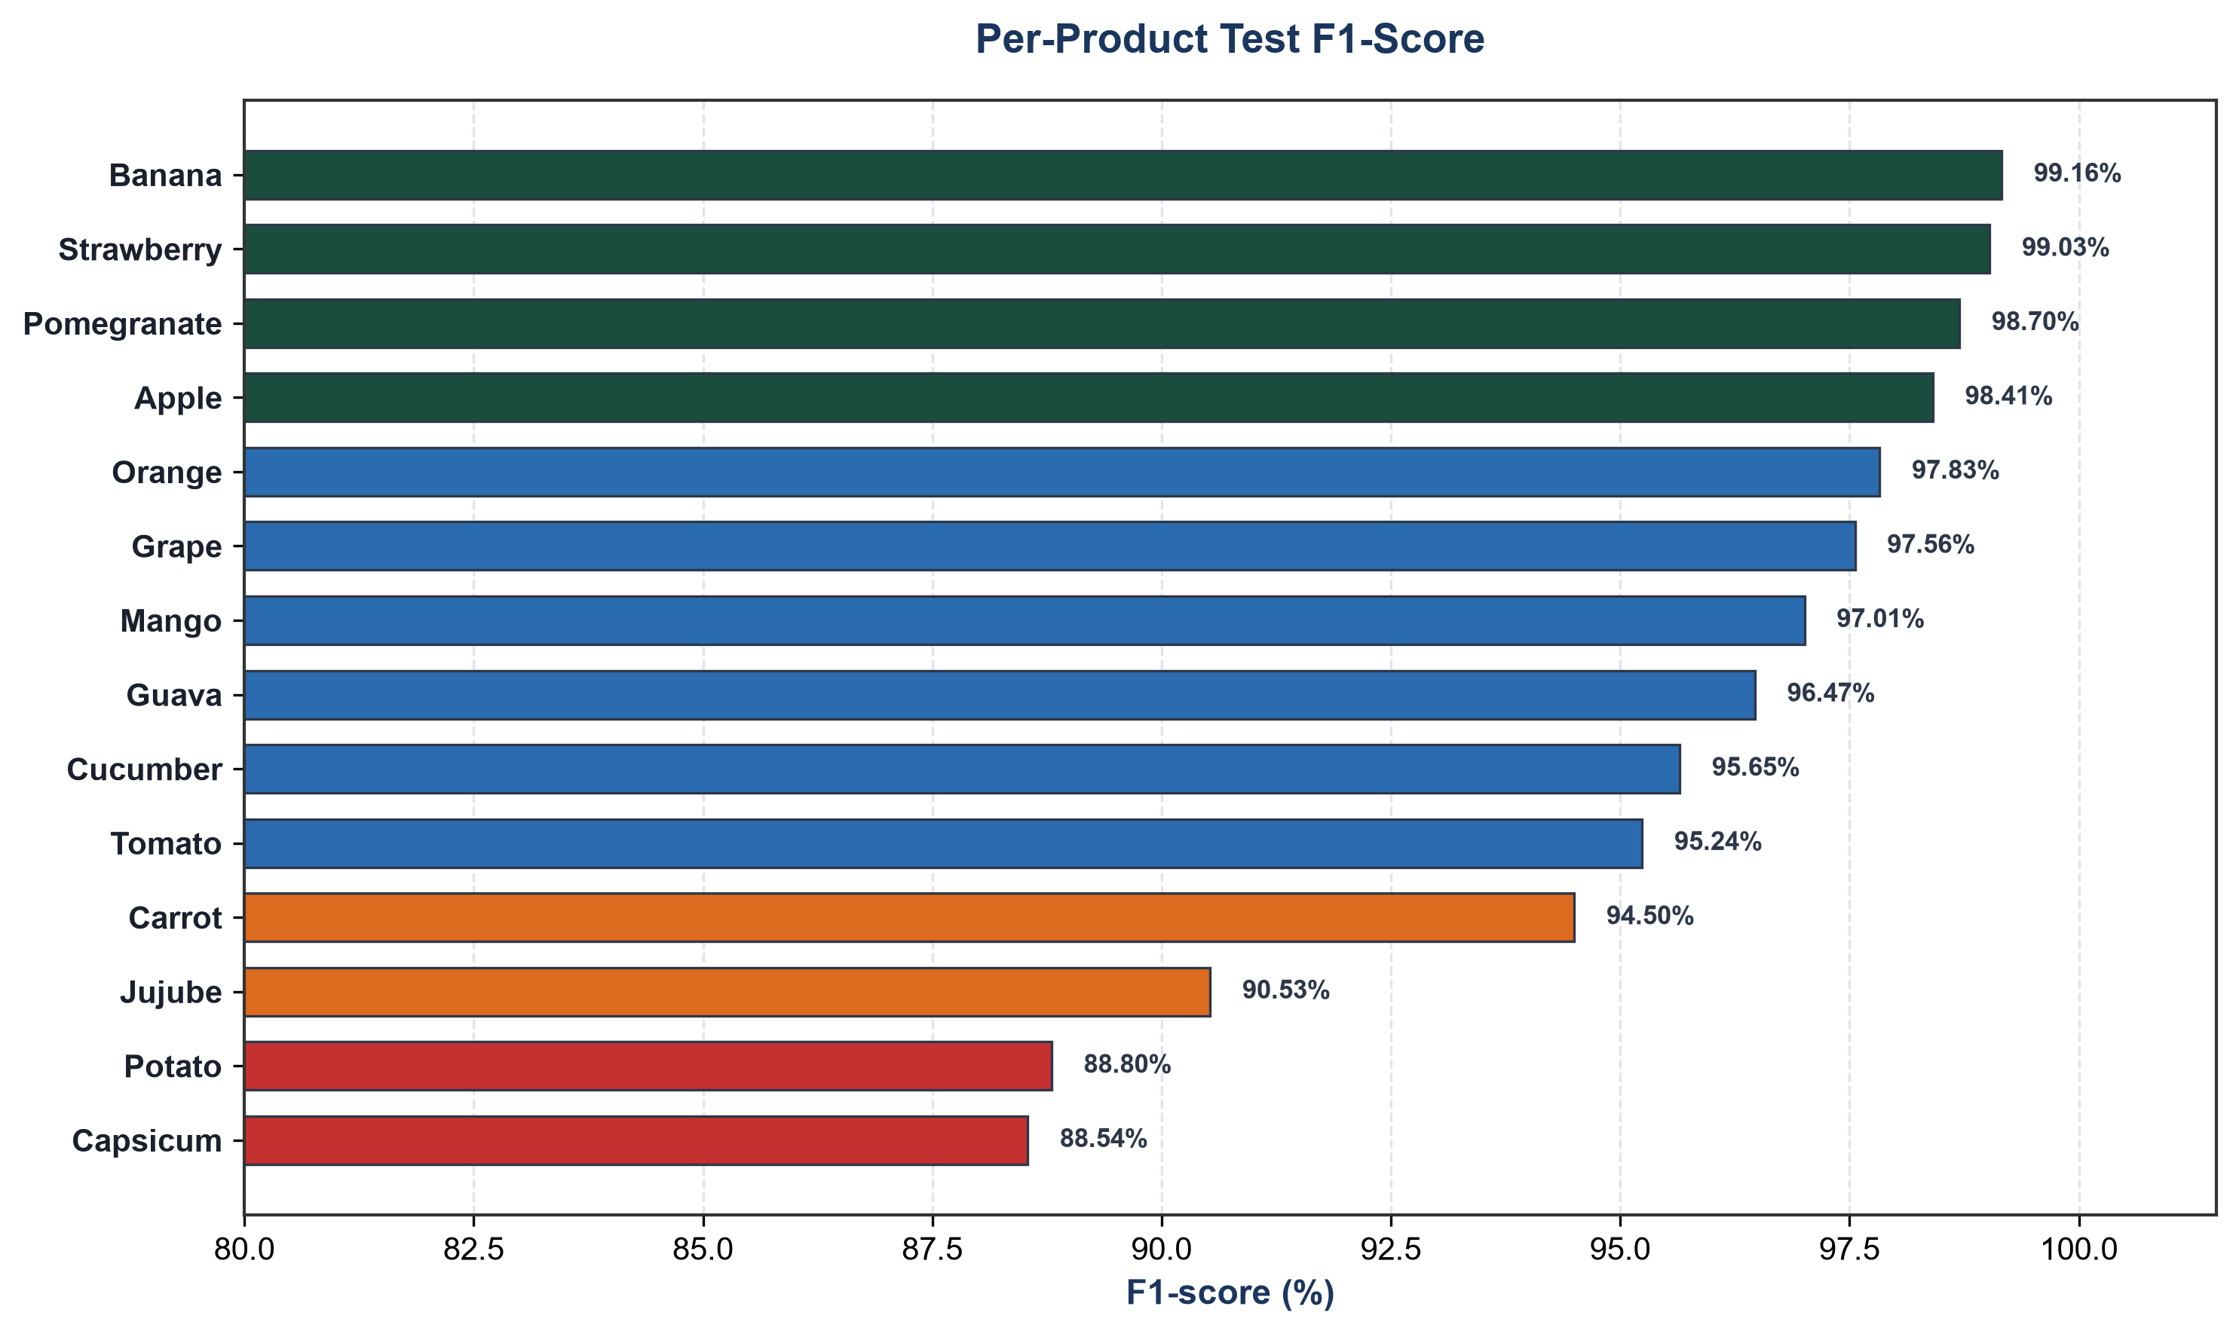
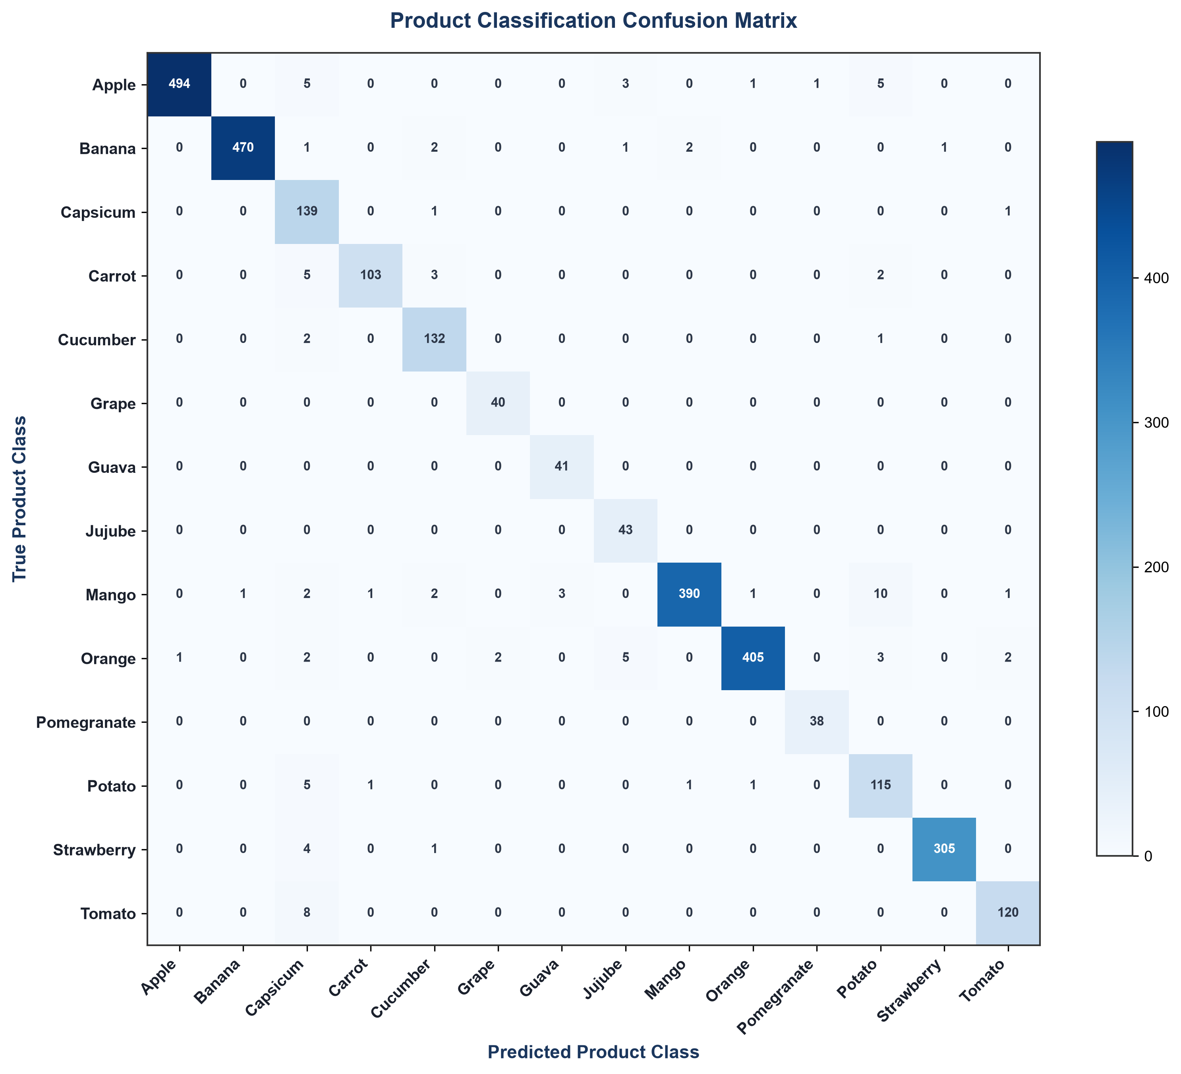
Results
Held-out test set, two curated datasets - evaluated honestly
96.8%
98.3%
34.7%
Product identification accuracy
Quality assessment accuracy
Near-duplicates found & controlled for via leakage-free split — confirming genuine generalisation
8

Slide 9
Technology Stack
BACKEND
Python, FastAPI, JWT authentication, SQLAlchemy ORM
FRONTEND
React (single-page application)
DATABASE
PostgreSQL
COMPUTER VISION
PyTorch (ResNet-18 multi-head classifier), YOLOv8 (object detection), OpenCV (classical scoring)
OTHER
ReportLab (PDF invoices), perceptual hashing (dataset deduplication), Docker (containerisation)
7

Slide 10
On Quality: Limitations & Evaluation Integrity
Dense, overlapping produce is harder to detect cleanly - future work: instance segmentation
Some products (carrot, Mango) grade less reliably - a data-availability limitation, not a design flaw
Visually similar produce (apple / tomato) is occasionally confused
Only two datasets used for training; a third was assessed and excluded after raising near-duplicate contamination from 34.7% to 61.8%
Quality is graded by computer vision; organic provenance is verified separately by certificate and admin approval - a deliberate design boundary
Reliability depends on reasonable photographic conditions
9

Slide 11
Conclusion & Future Work
A working, honestly evaluated trust layer for direct organic trade in Ireland
Novel dual-inspection protocol for objective, evidence-based dispute resolution
Future: instance segmentation for dense piles, more training data for weaker products
Future: real payment integration, cloud deployment, certificate-based path for meat and dairy
Thank you
Questions?
10

